Slide 1

REQUIREMENTS ANALYSIS AND DESIGNS
GROUP: 10

Slide 2
REQUIREMENTS ANALYSIS AND DESIGNS
GROUP: 10

Slide 3
GROUP 10:
01
02
03
04
520H0218 – Nguyễn Bá Duy
521H0497 – Nguyễn Phúc Minh Đăng
521H0072 – Nguyễn Thiên Huy
520H0553 – Thái Ngọc Thiên Long
05
520H0695 – Trang Thanh Tùng

Slide 4
ONLINE MOVIE TICKETS BOOKING SYSTEM

Slide 5
1. Determine requirements
Introduction
An online movie ticket booking system facilitates the purchasing of movie tickets to its customers.
Investigating the Situation
Problem: Long lines at the box office, limited information about showtimes, inconvenient ticket purchasing for customers
Opportunity: increased sales, enhanced customer experience, improved operational efficiency

Slide 6
1. Determine requirements
Analyzing Stakeholders
Primary stakeholders:
Customers
Visitors
Admins
System
Secondary stakeholders:
Payment gateway providers

Slide 7
1. Determine requirements
Listing and Classifying the Requirements
Functional Requirements:
Movie listings: Display current and upcoming movies with details (synopsis, trailers, ratings).
Search functionality: Search by movie title, location, date, time.
Theater selection: Allow users to choose their preferred location.
Showtime listings: Clearly display available showtimes.
Seat selection: Interactive seat map for users to pick desired seats.
User registration/login: Secure system for customers to create accounts and store preferences.
Booking process: Streamlined ticket purchase steps.
Payment integration: Support multiple payment methods (credit/debit cards, e-wallets).
Ticket confirmation: Issue e-tickets or QR codes for entry.
Booking history: Allow users to view past bookings.
Cancellation/refund: Implement cancellation policies with clear refund information.

Slide 8
1. Determine requirements
Listing and Classifying the Requirements
NonFunctional Requirements:
Performance: Fast loading times, quick search results.
Reliability: System should have minimal downtime and handle high traffic.
Security: Protect customer data and payment information.
User interface: Intuitive, easy-to-use design across devices.
Accessibility: Meet accessibility standards (for users with disabilities, etc.).

Slide 9
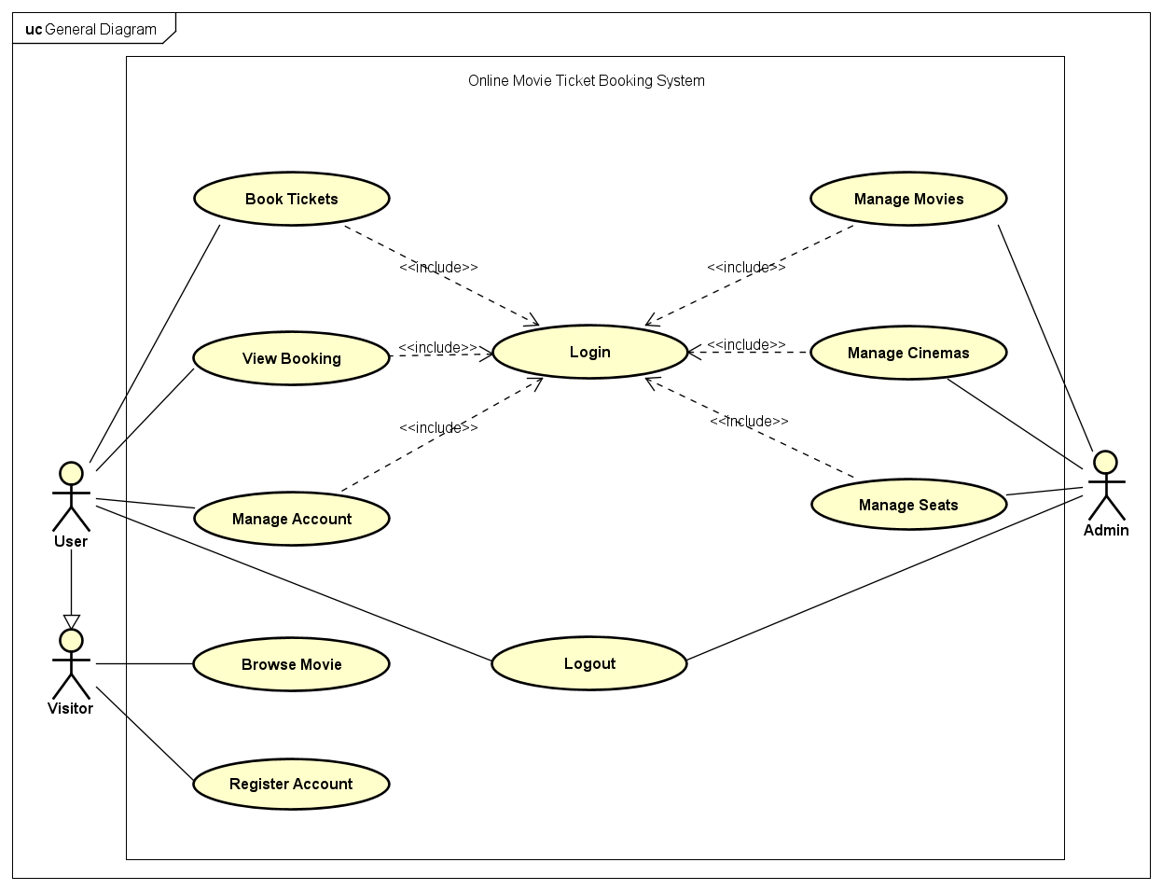
2. Functional modelling
General Use Case

Slide 10
2. Functional modelling
Decomposed use cases
Book Tickets
View Booking
Manage Account
Manage Movies
Manage Cinemas
Manage Seats
Login
Logout
Register Account

Slide 11
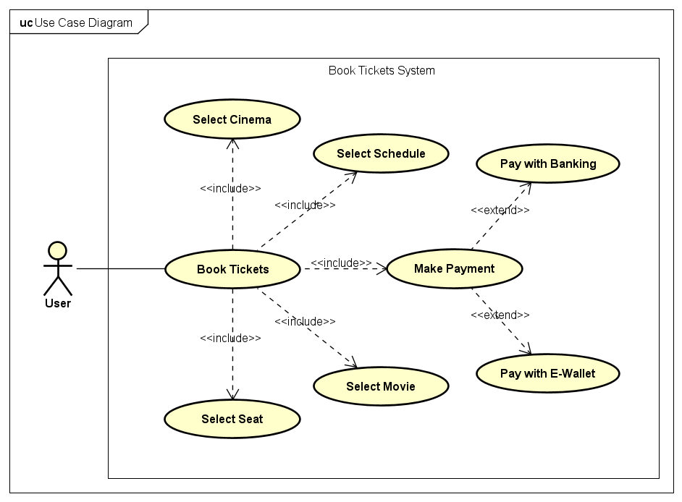
2. Functional modelling
Book Tickets Use Case

Slide 12
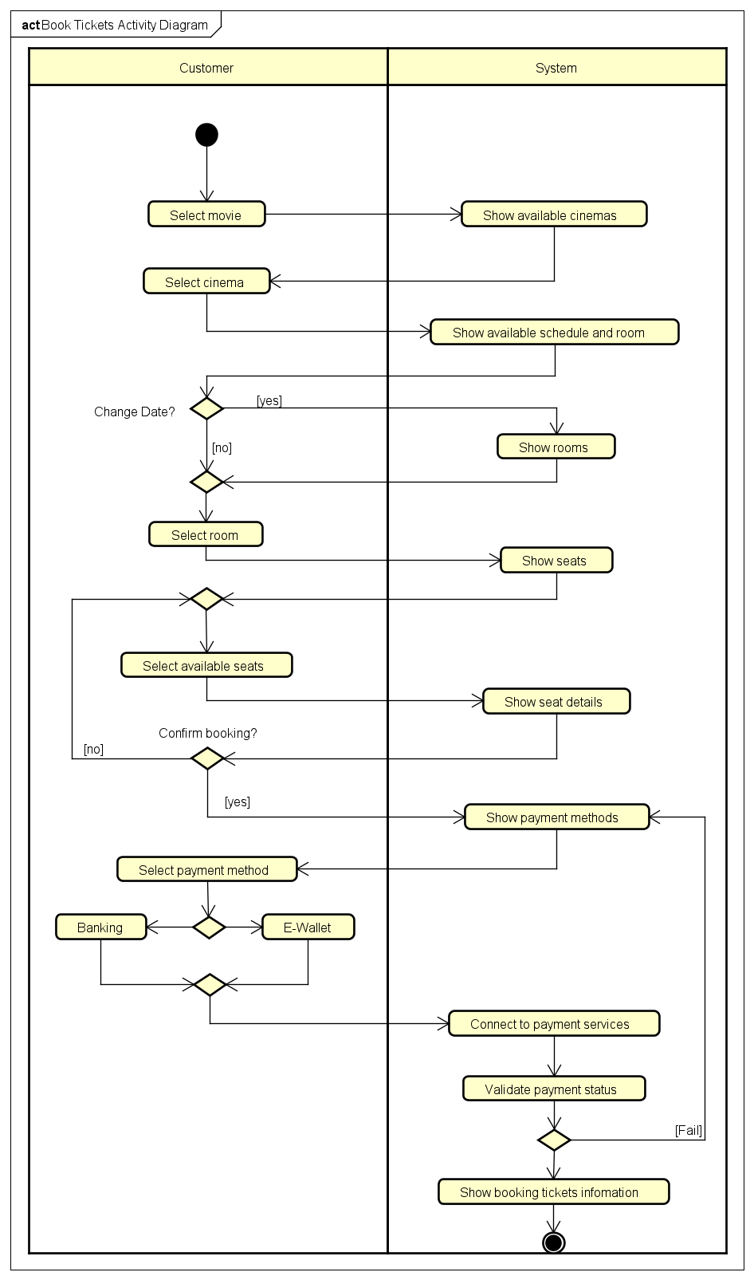
Book Tickets
Activity Diagram

Slide 13
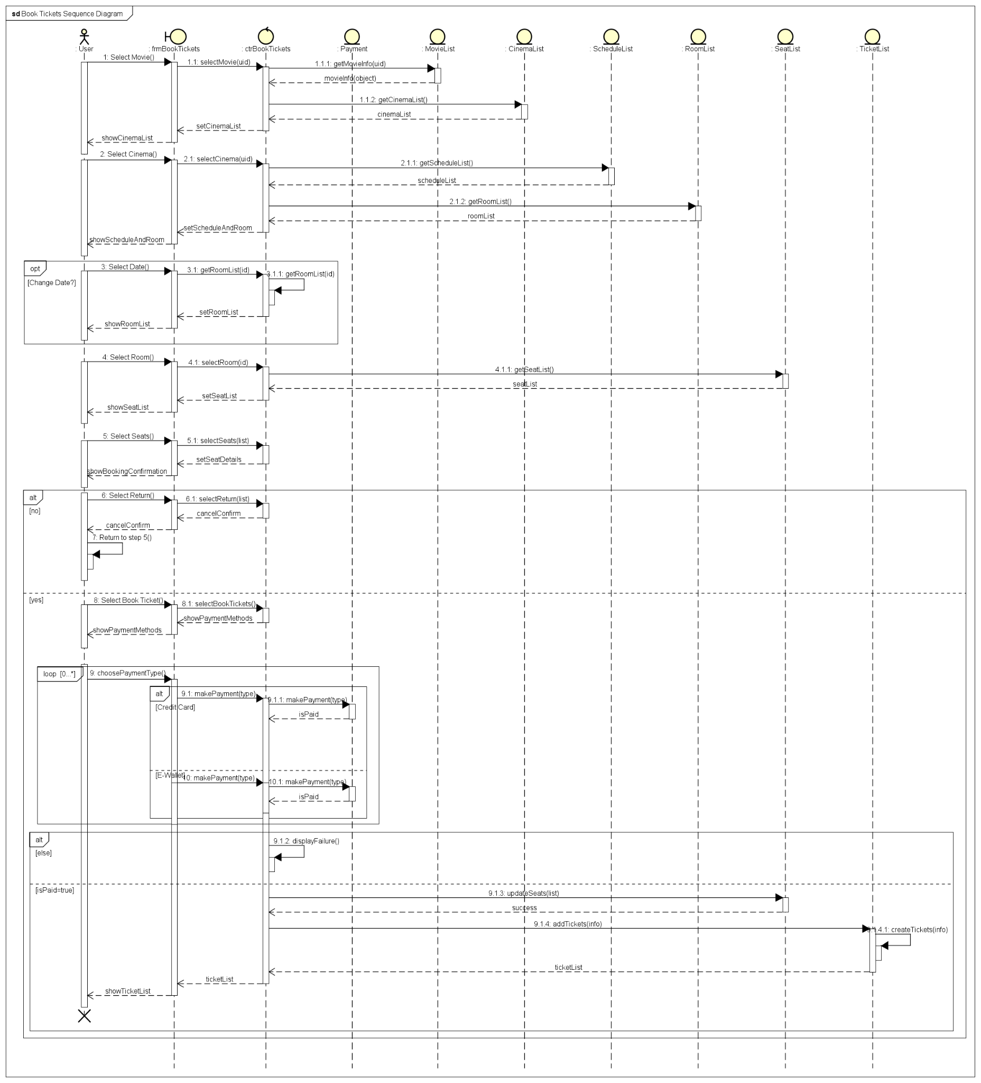
2. Functional modelling
Book Tickets Sequence Diagram

Slide 14
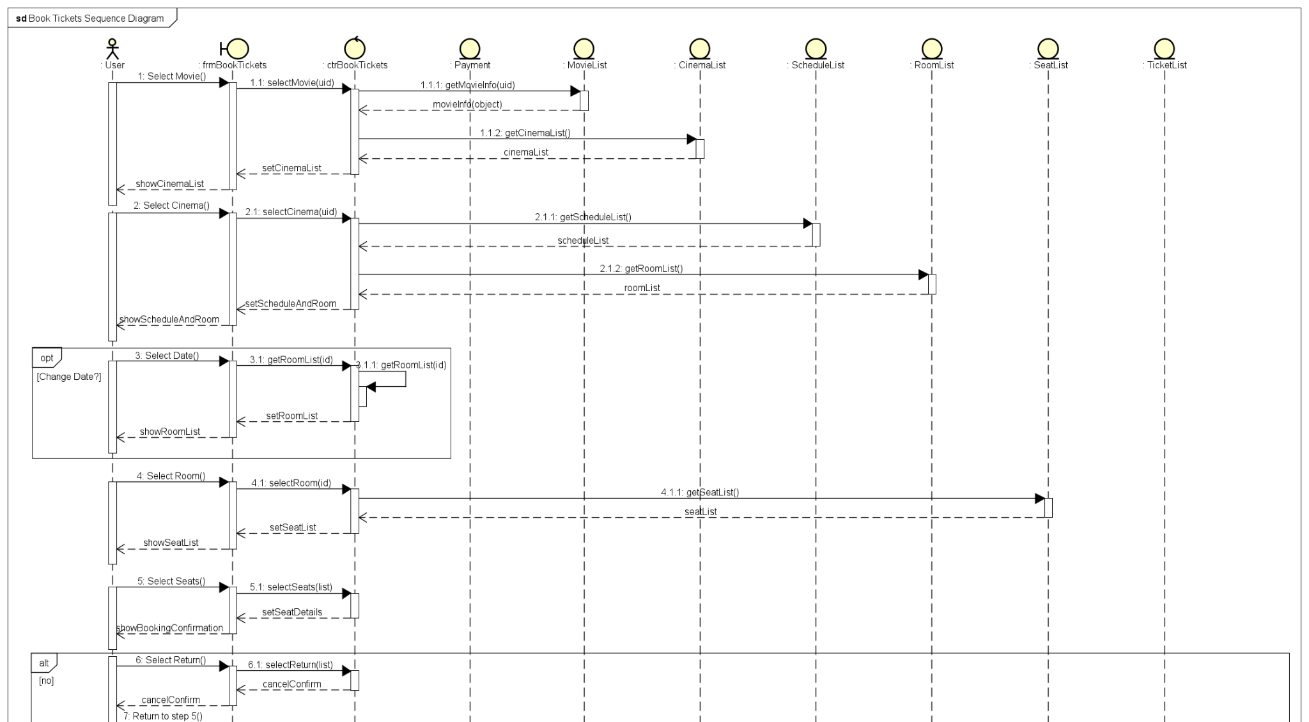
2. Functional modelling
Book Tickets Sequence Diagram

Slide 15
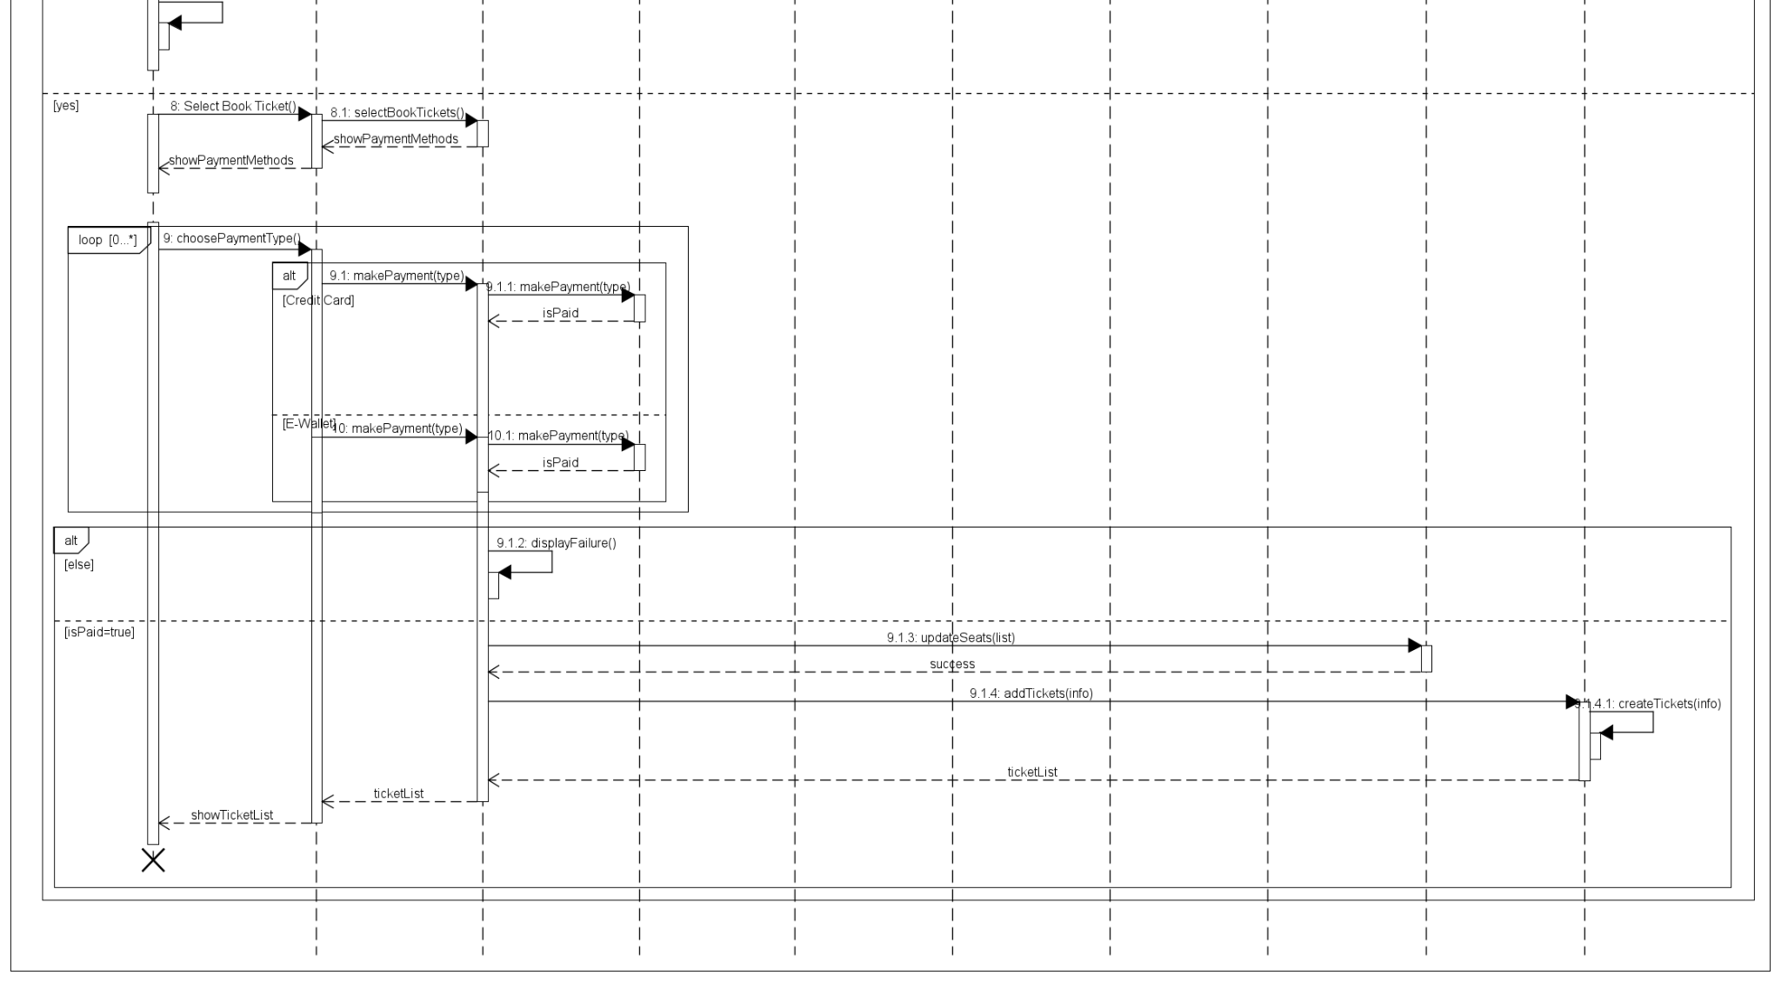
2. Functional modelling
Book Tickets Sequence Diagram

Slide 16
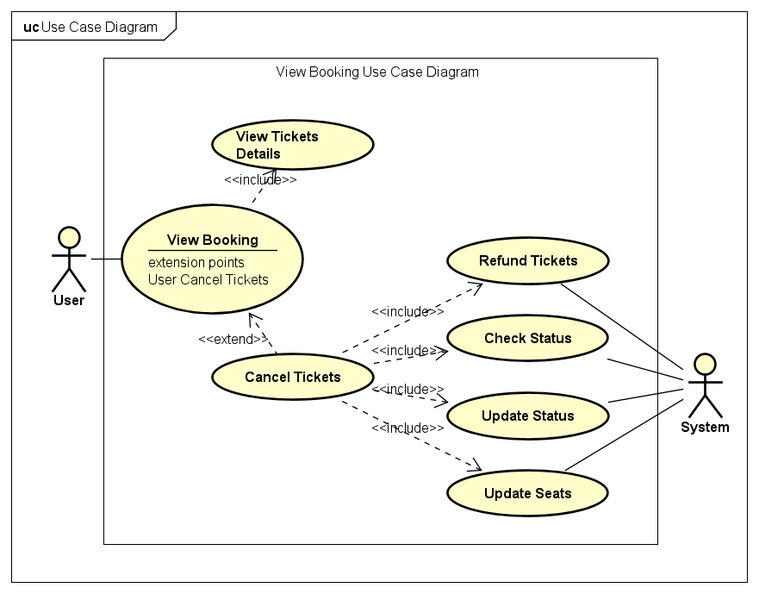
2. Functional modelling
View Booking Use Case

Slide 17
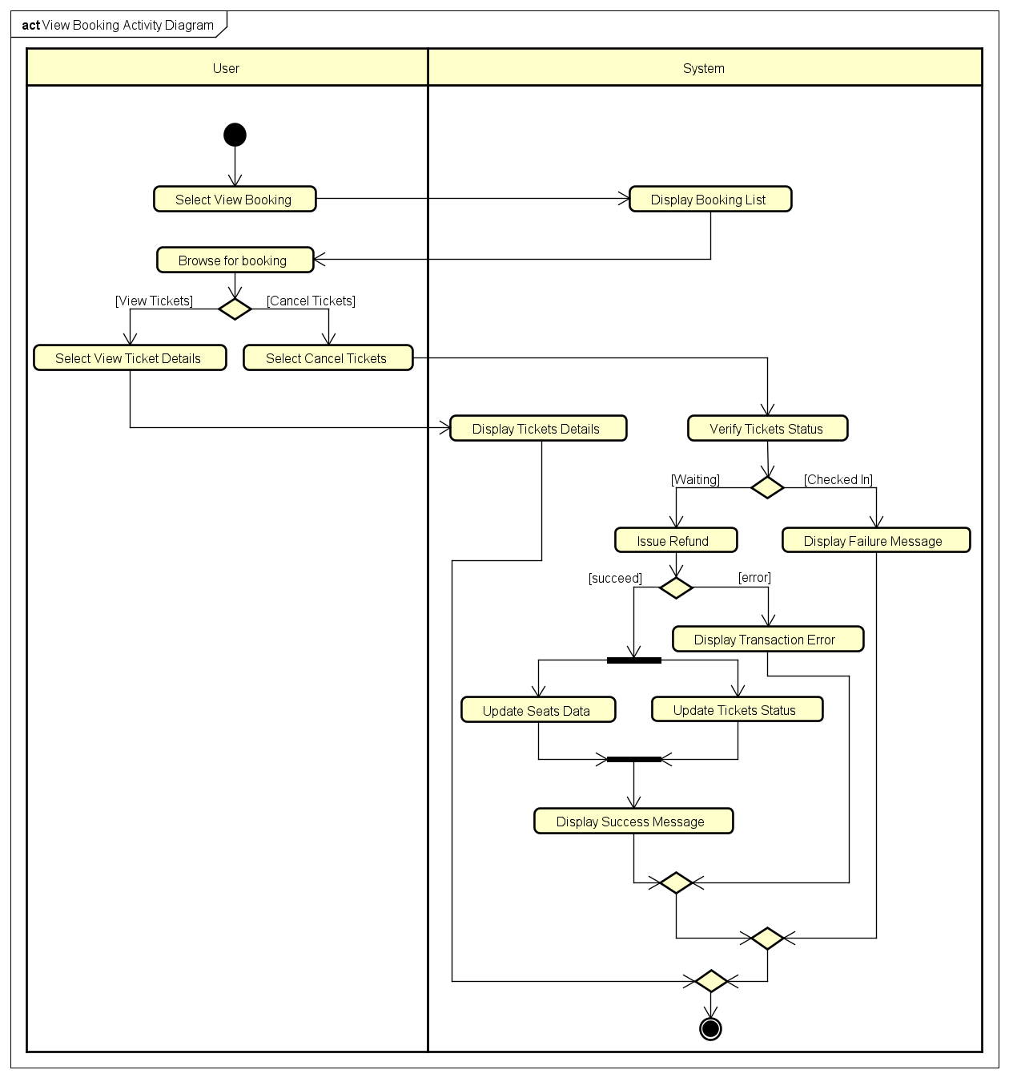
View Booking
Activity Diagram

Slide 18
View Booking Sequence Diagram

Slide 19
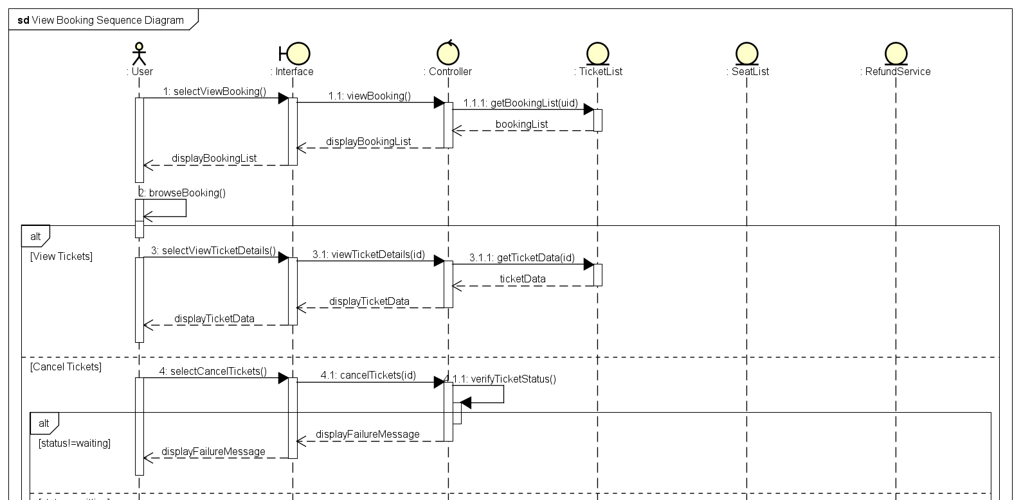
View Booking Sequence Diagram

Slide 20
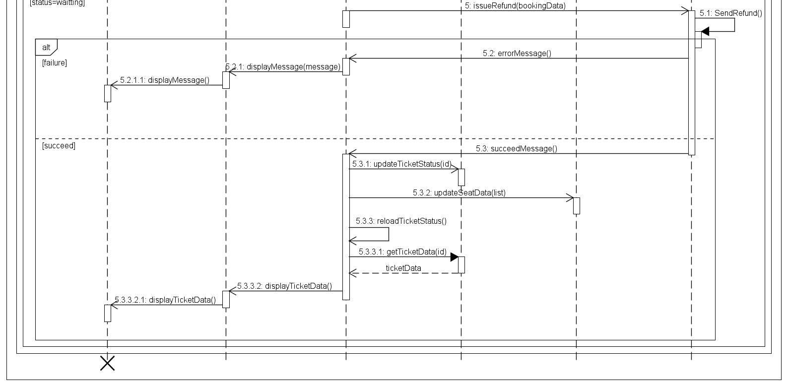
View Booking Sequence Diagram

Slide 21
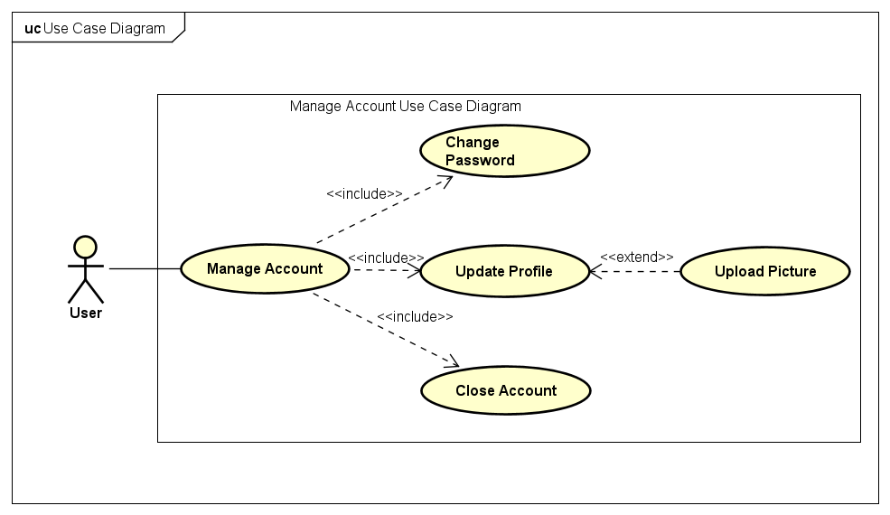
2. Functional modelling
Manage Account Use Case

Slide 22
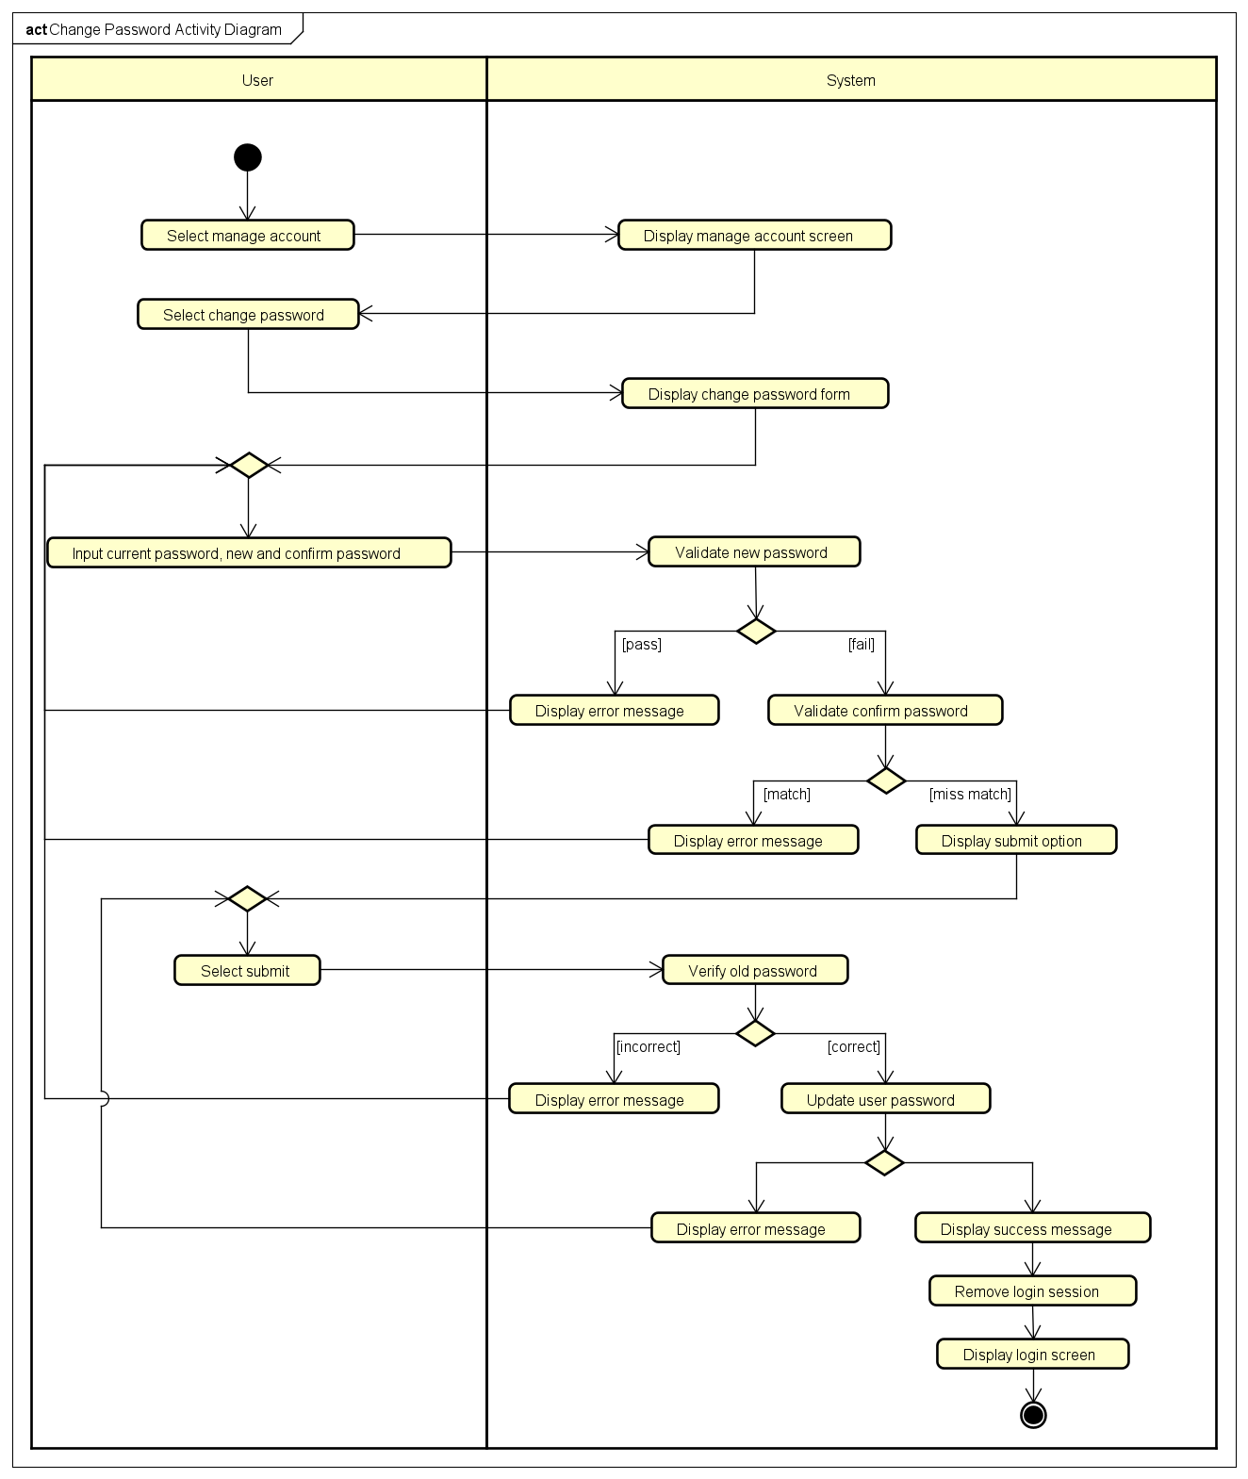
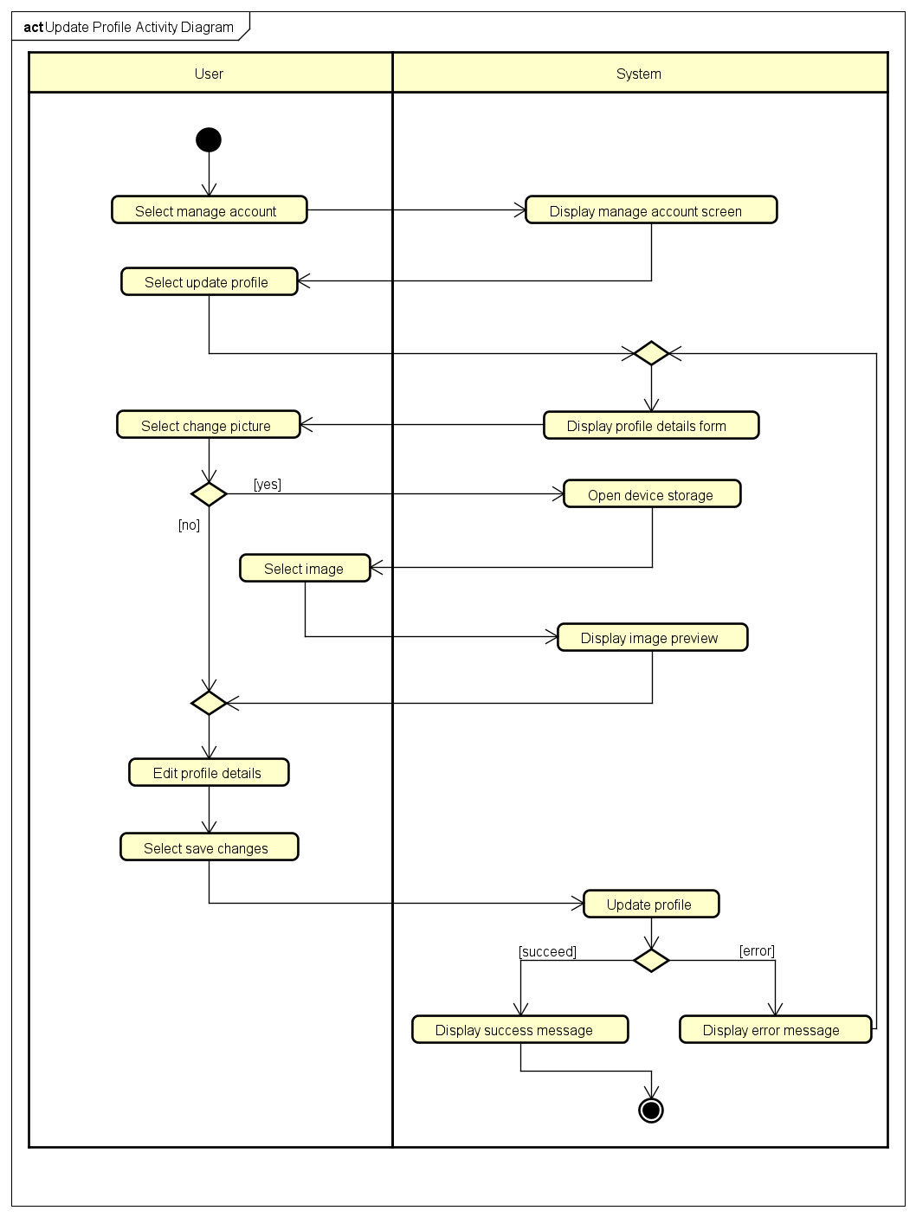
Manage Account Activity Diagram

Slide 23
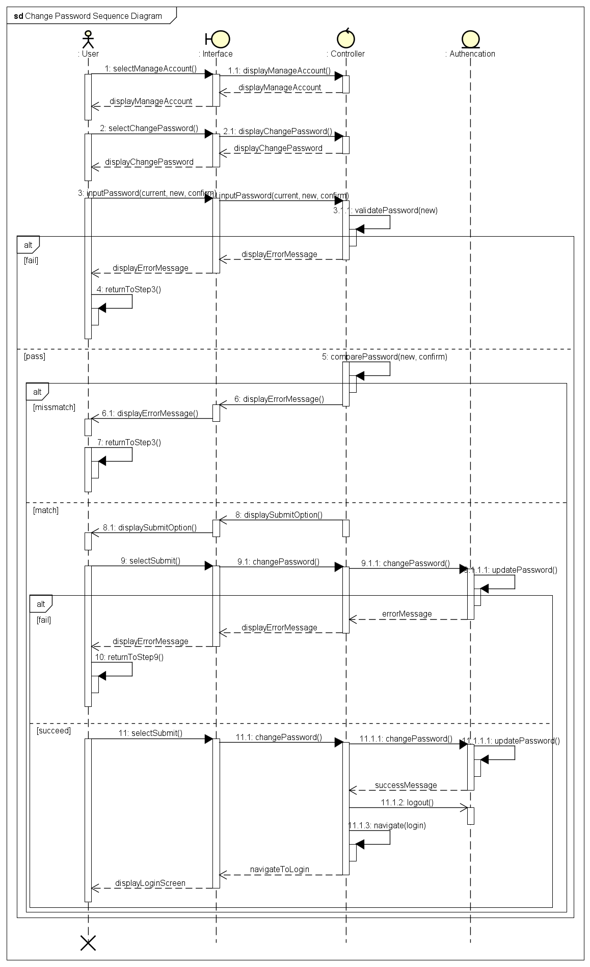
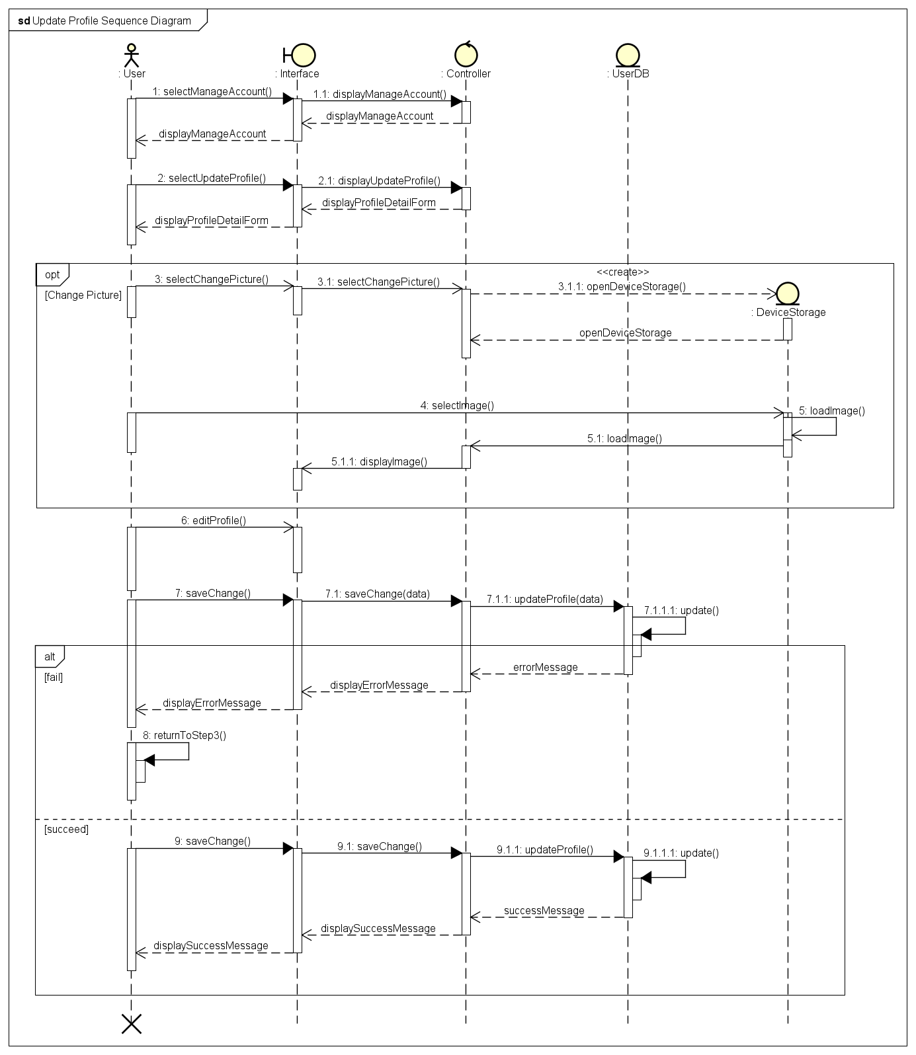
Manage Account Sequence Diagram

Slide 24
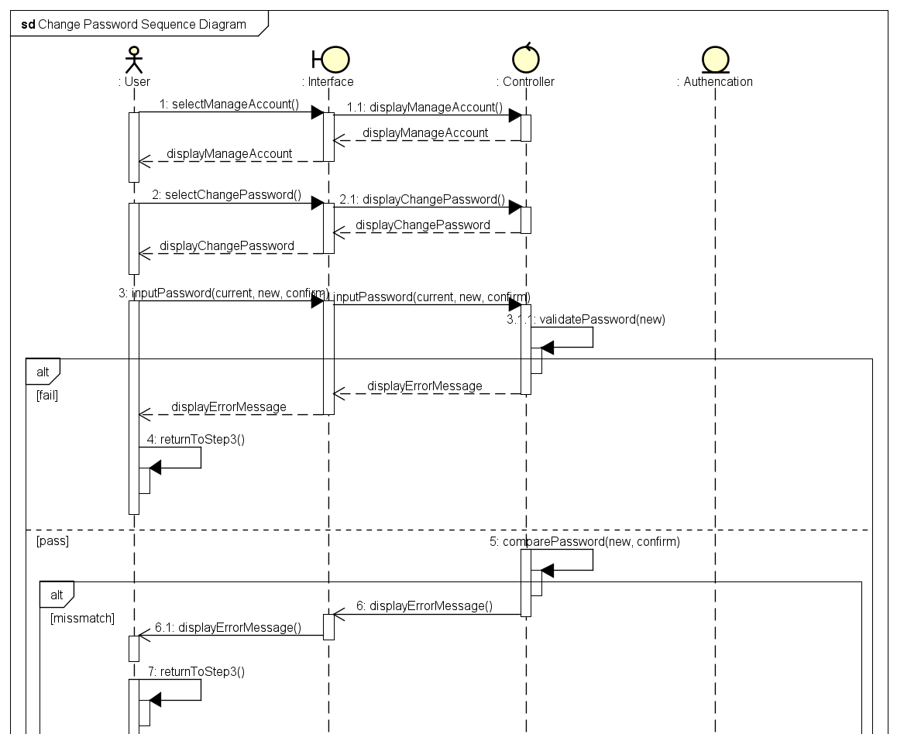
Change Password Sequence Diagram

Slide 25
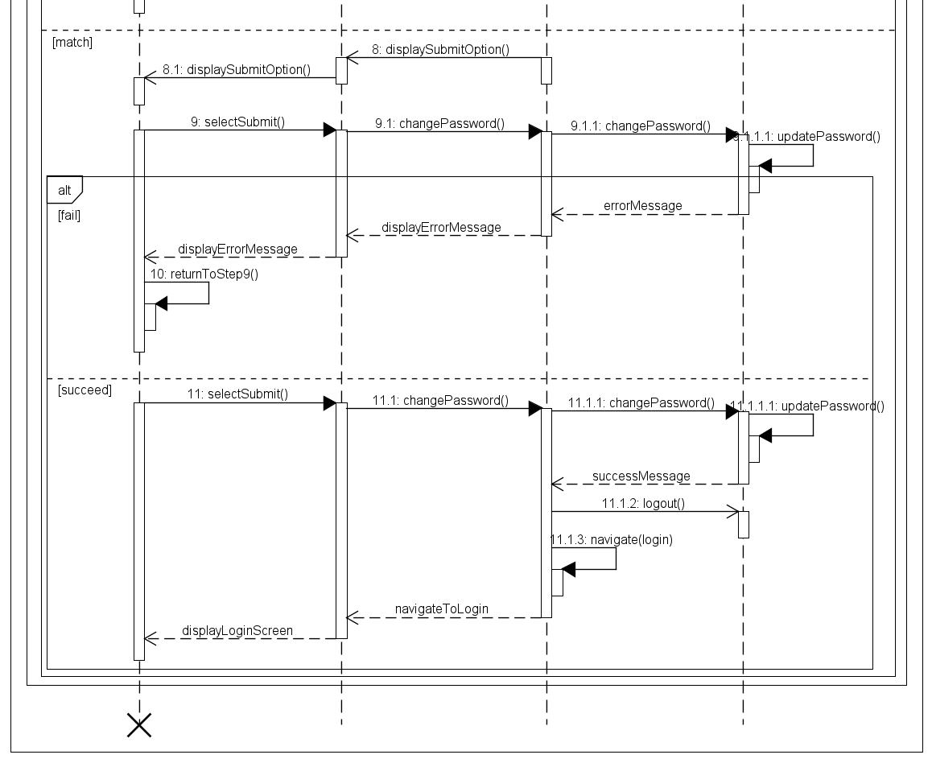
Change Password Sequence Diagram

Slide 26
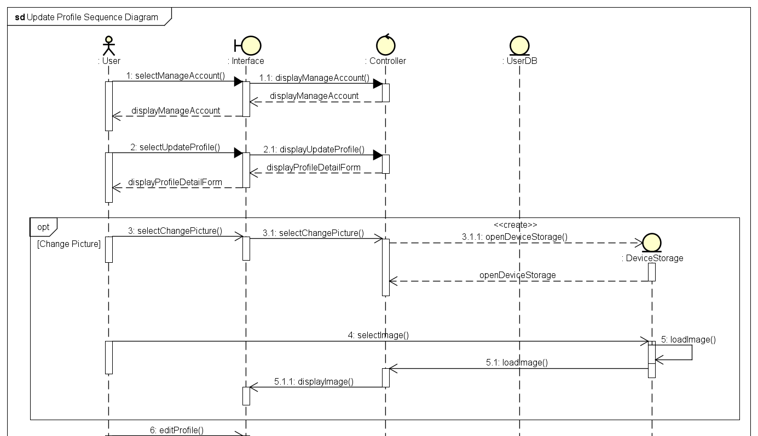
Update Profile Sequence Diagram

Slide 27
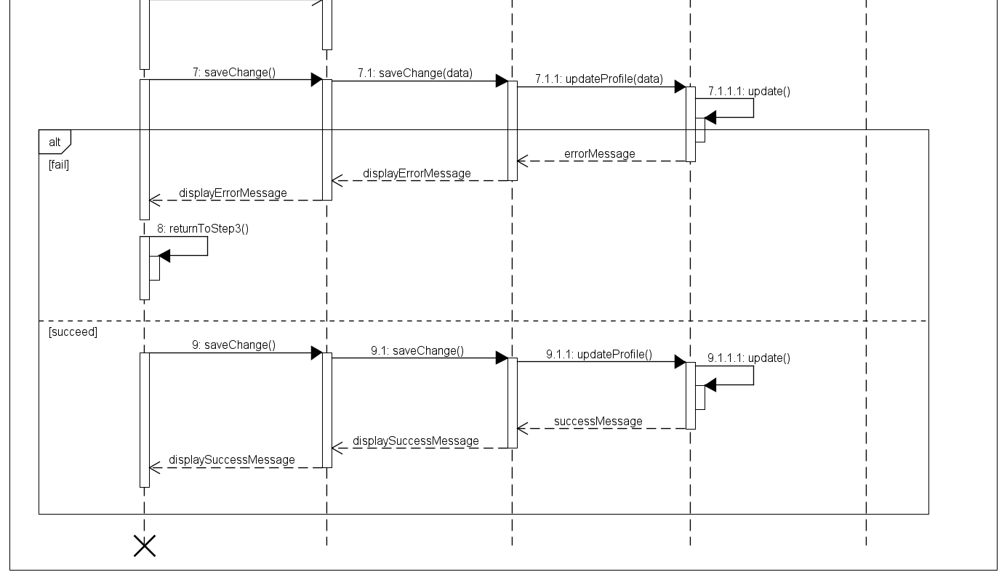
Update Profile Sequence Diagram

Slide 28
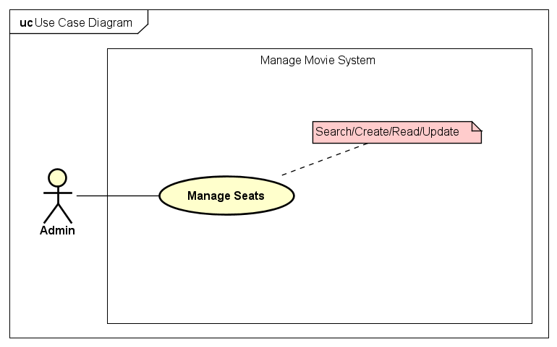
2. Functional modelling
Manage Movies Use Case

Slide 29
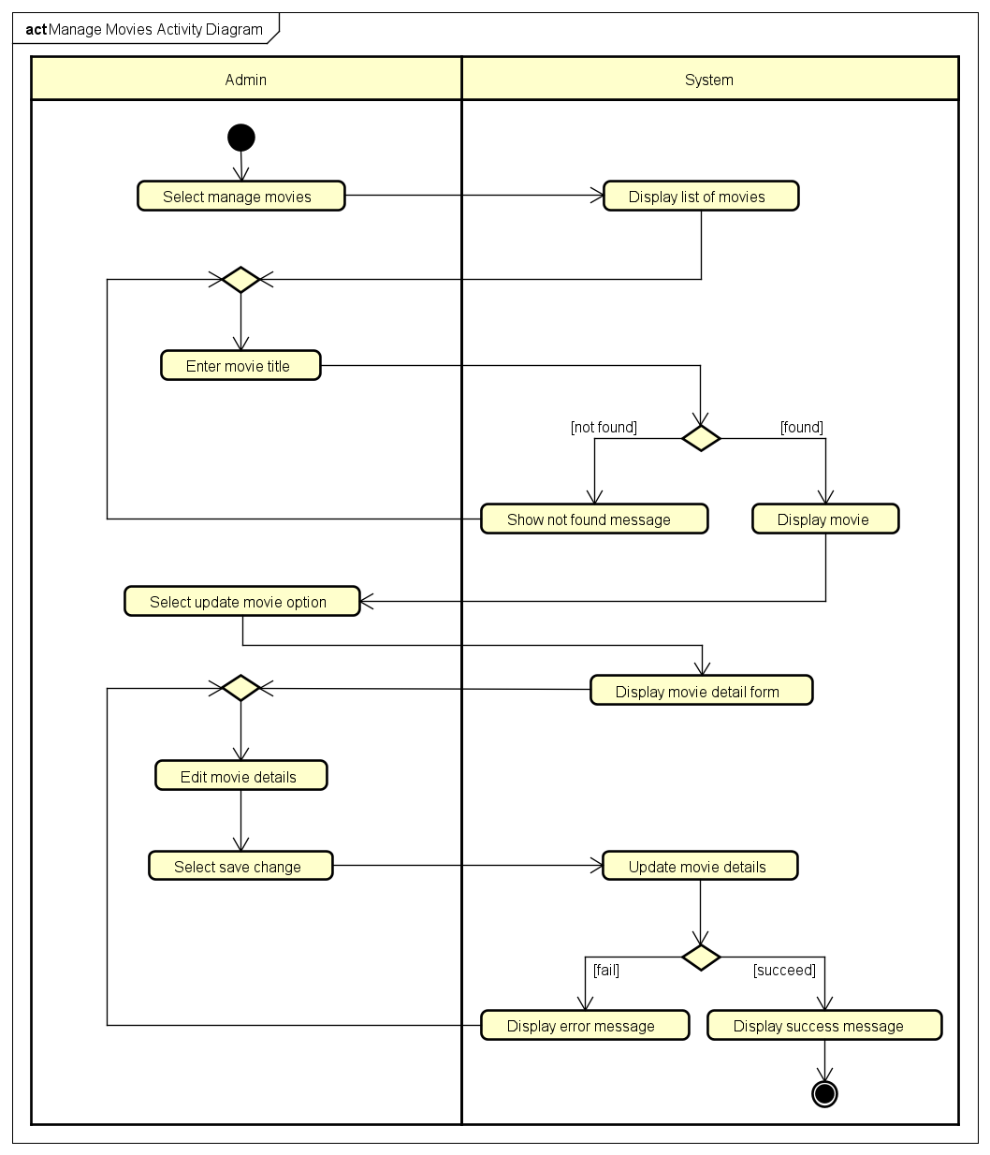
Manage Movies
Activity Diagram

Slide 30
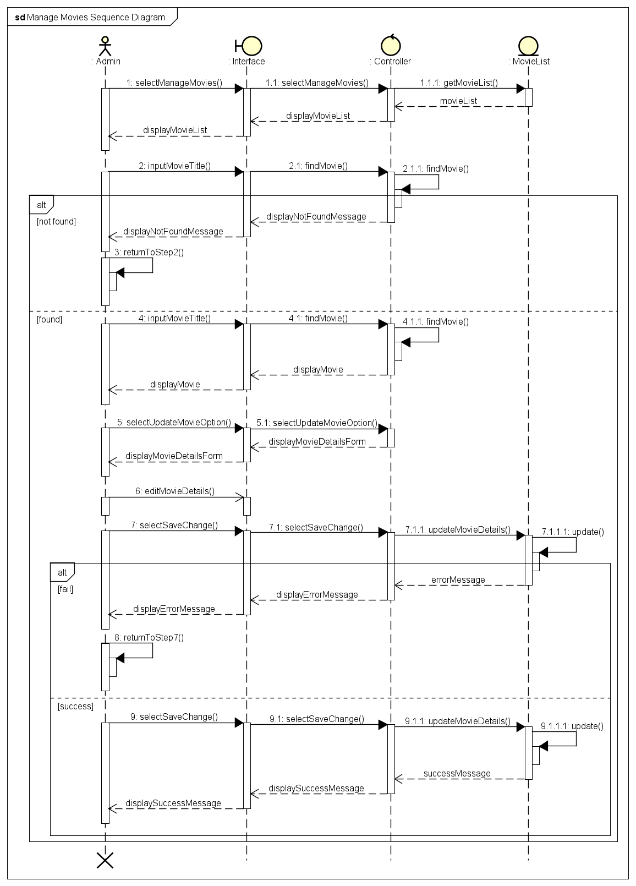
Manage Movies Sequence Diagram

Slide 31
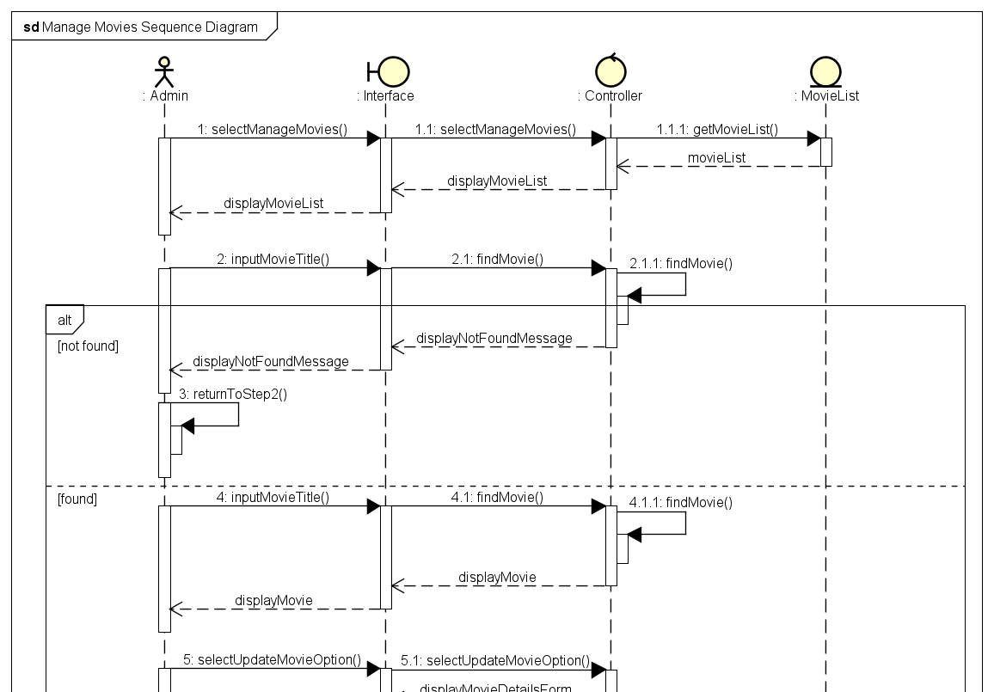
Manage Movies Sequence Diagram

Slide 32
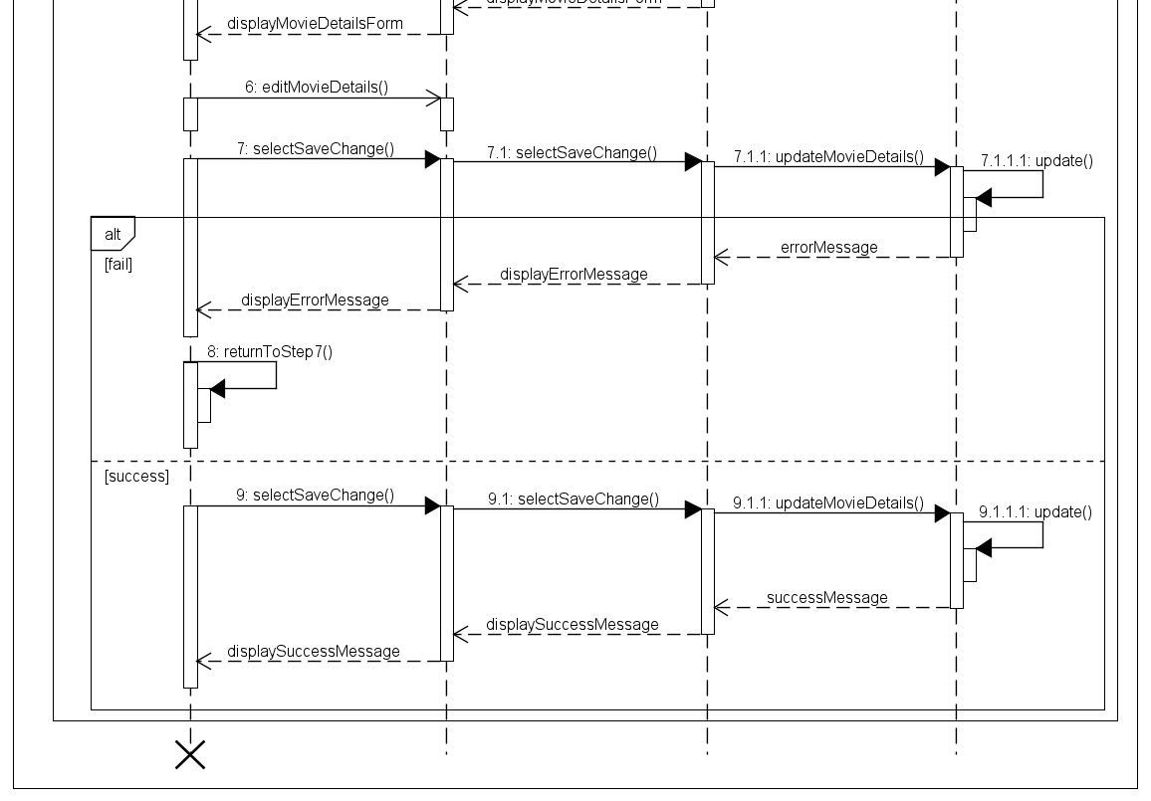
Manage Movies Sequence Diagram

Slide 33
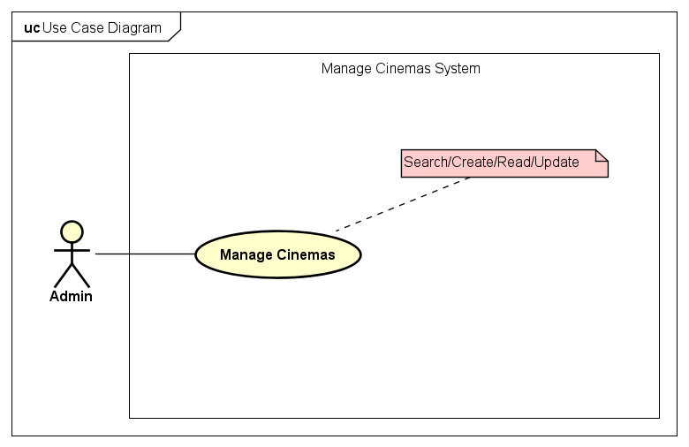
2. Functional modelling
Manage Cinemas Use Case

Slide 34
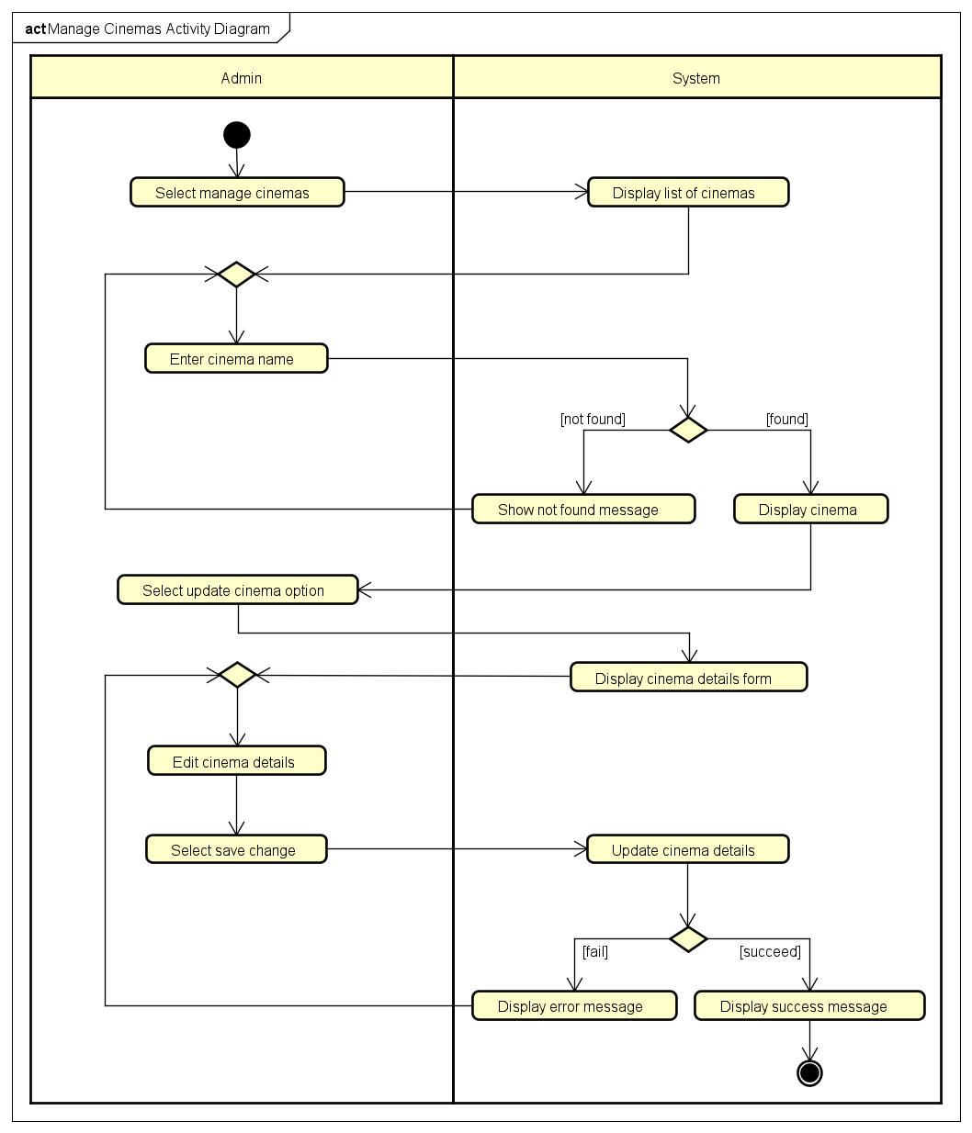
Manage Cinemas
Activity Diagram

Slide 35
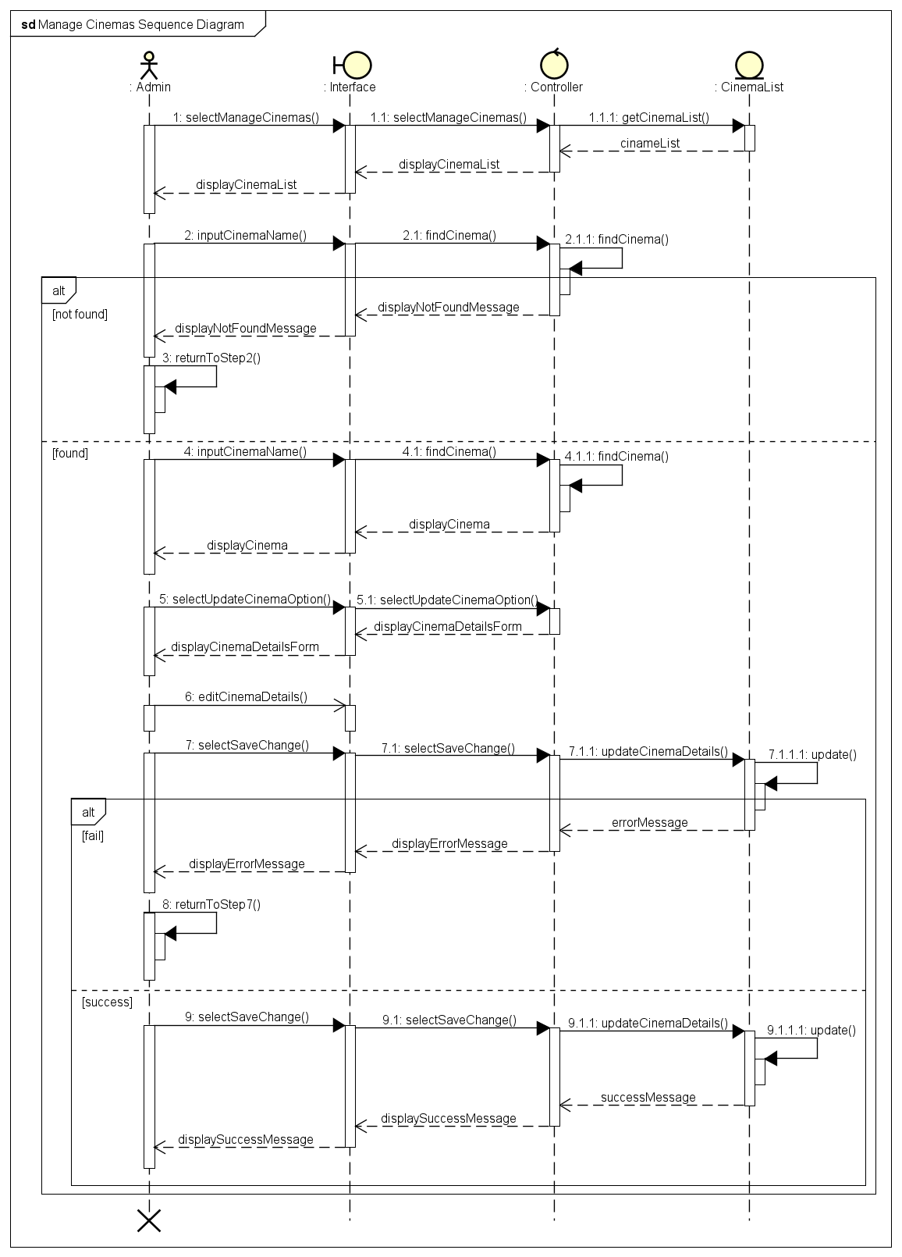
Manage Cinemas Sequence Diagram

Slide 36

Manage Cinemas Sequence Diagram

Slide 37
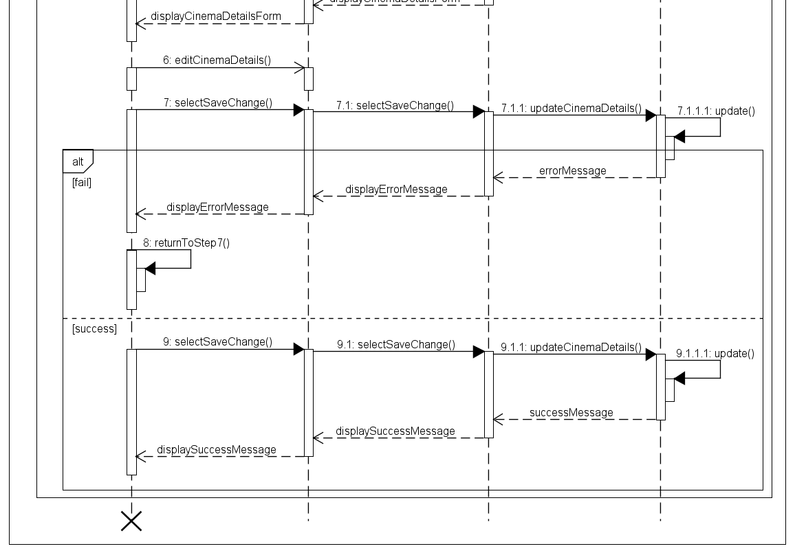
Manage Cinemas Sequence Diagram

Slide 38

2. Functional modelling
Manage Seats Use Case

Slide 39
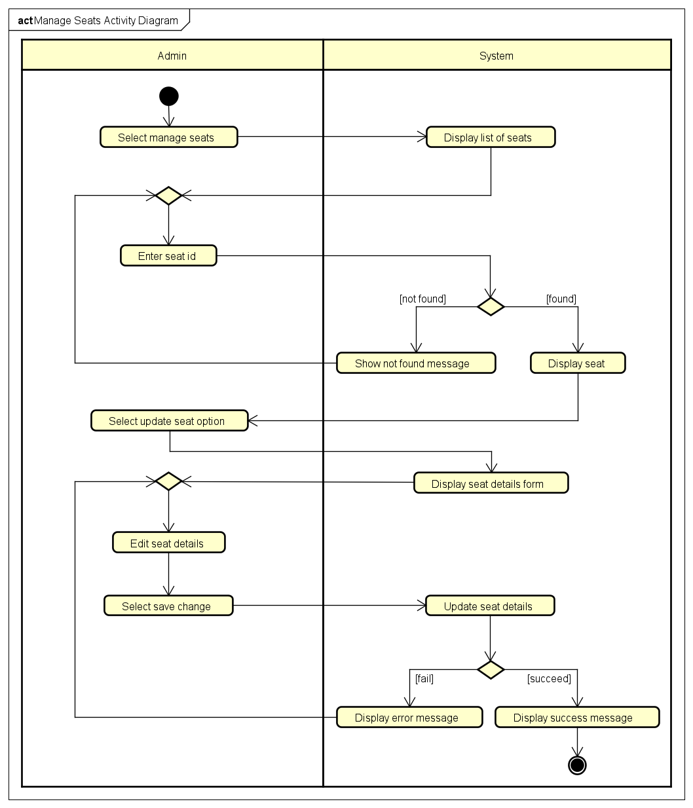
Manage Seats
Activity Diagram

Slide 40

Manage Seats Sequence Diagram

Slide 41

Manage Seats Sequence Diagram

Slide 42

Manage Seats Sequence Diagram

Slide 43
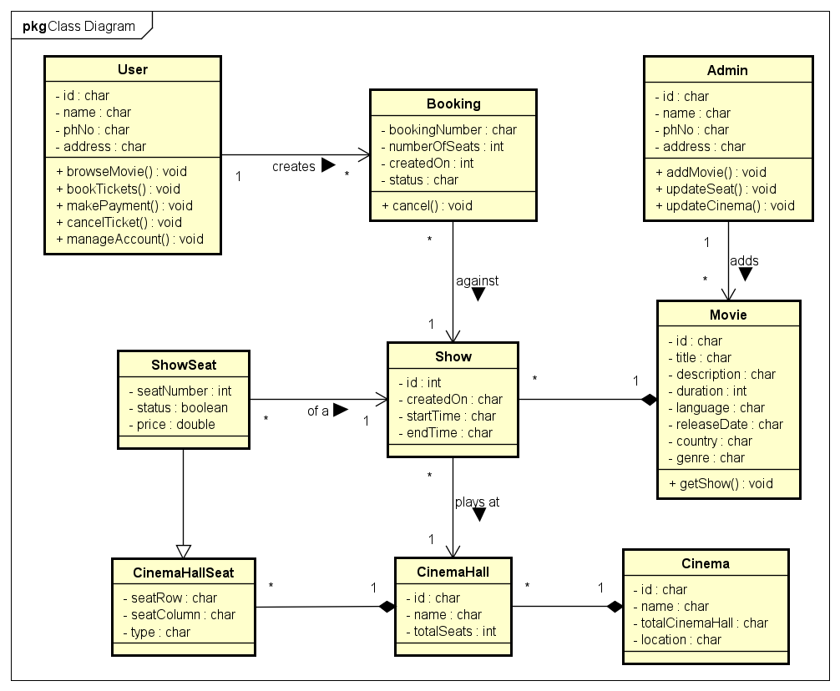
3. Class Diagram

Slide 44
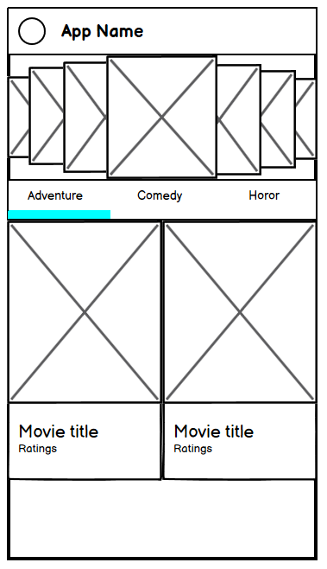
4. User Interface Design
Wireframe
Landing Screen

Slide 45
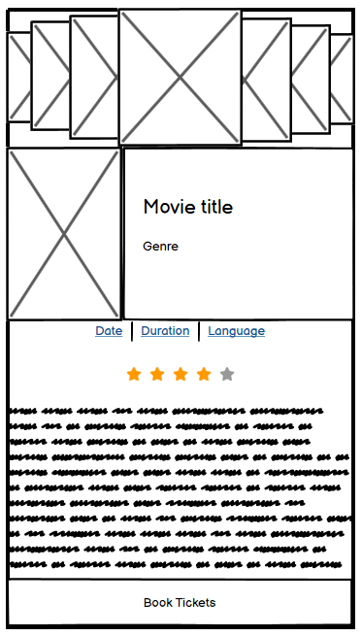
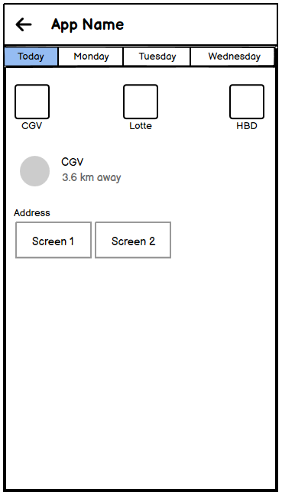
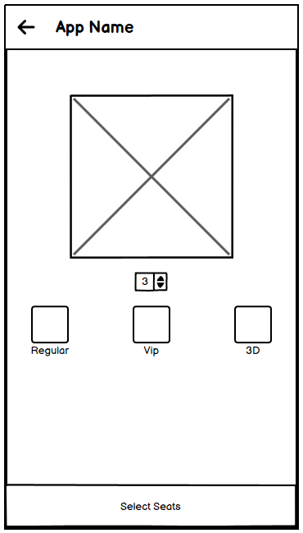
4. User Interface Design
Book Tickets
Screen 1
Screen 2
Screen 3

Slide 46
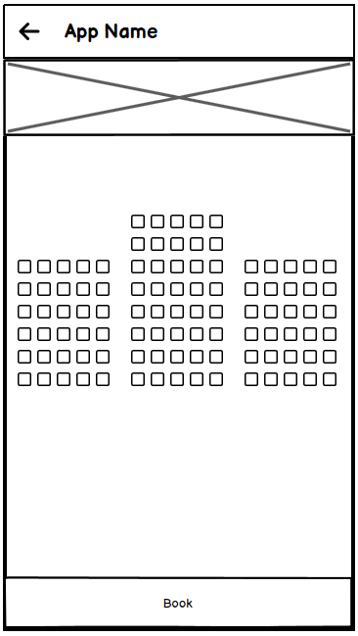
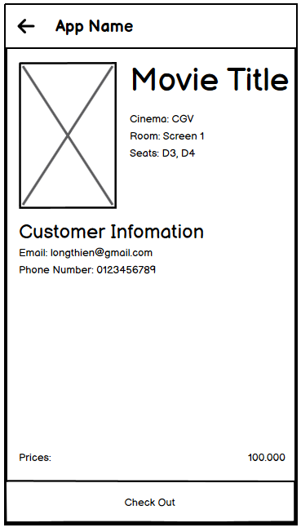
4. User Interface Design
Book Tickets
Screen 4
Screen 5

Slide 47
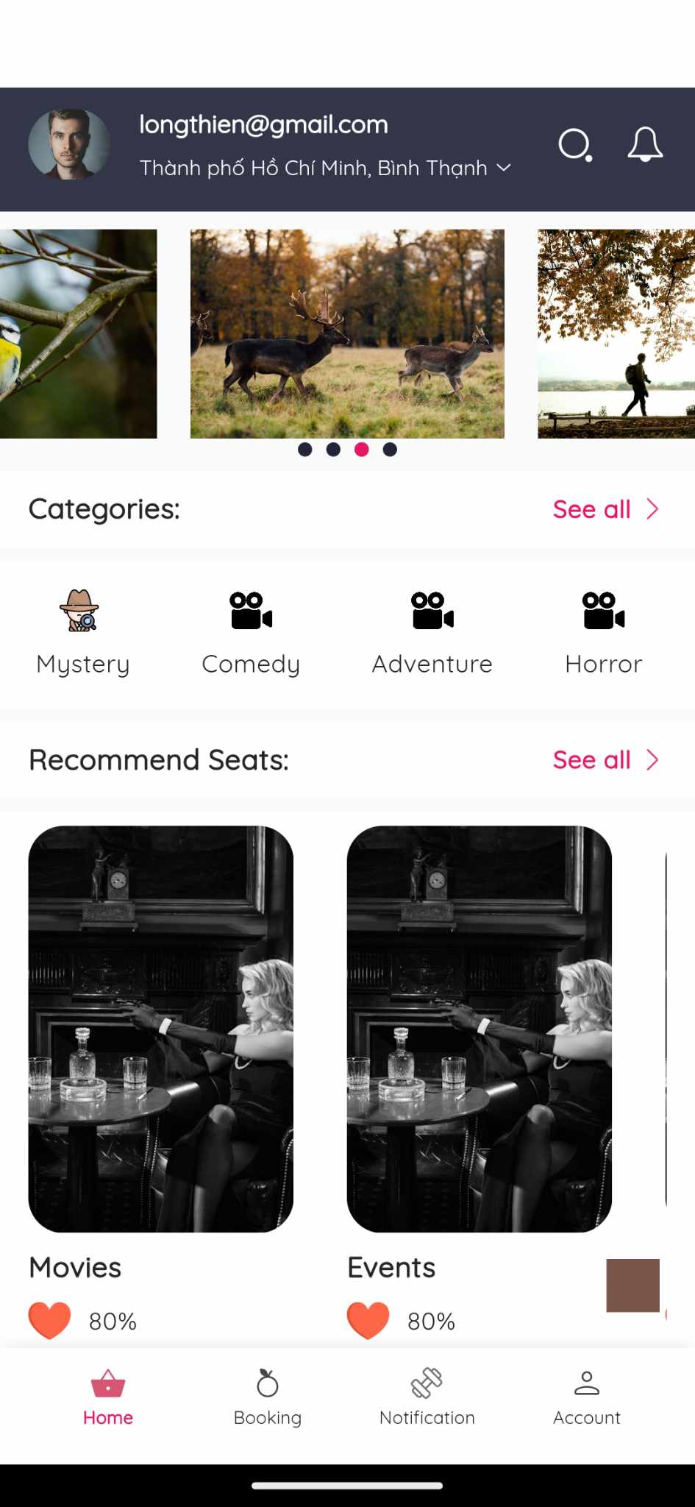
4. User Interface Design
2. Presentation
Landing Screen

Slide 48
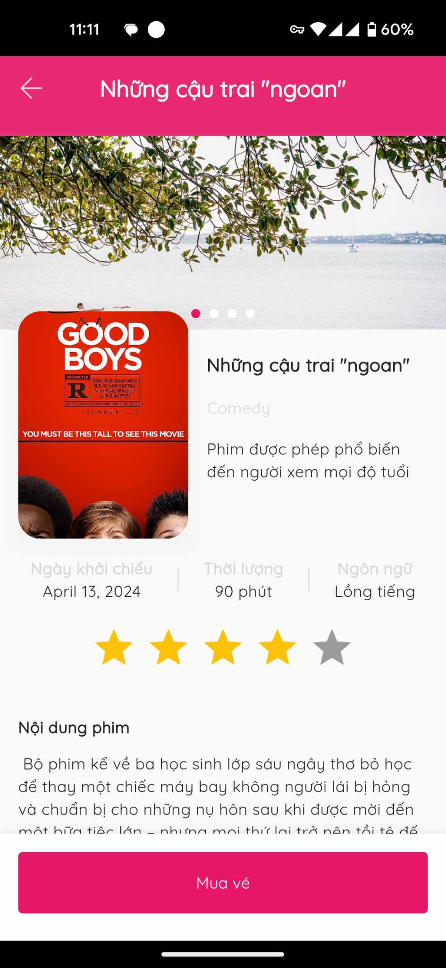
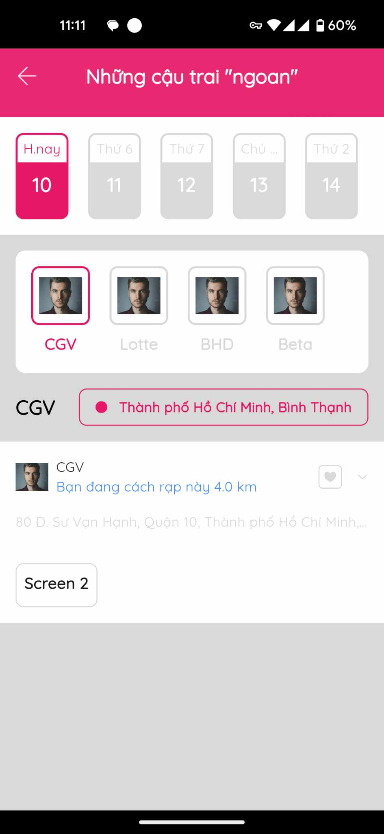
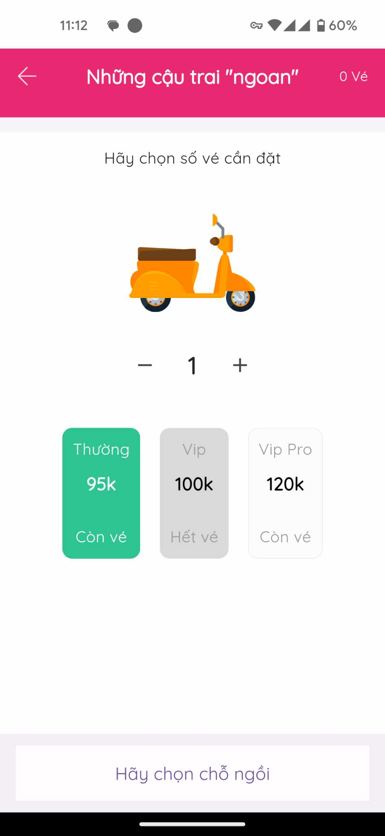
4. User Interface Design
Book Tickets
Screen 1
Screen 2
Screen 3

Slide 49
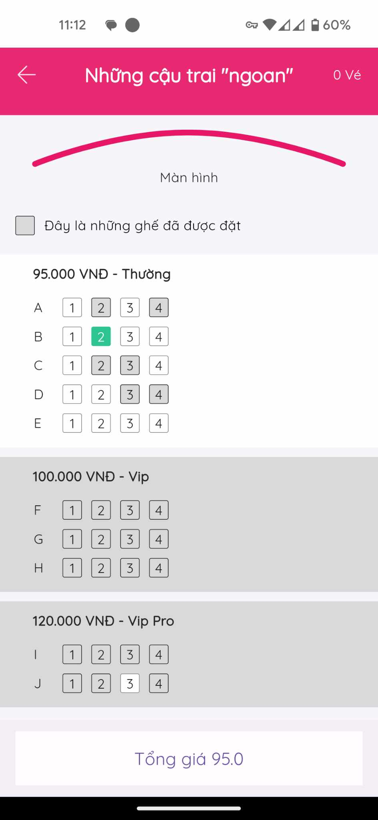
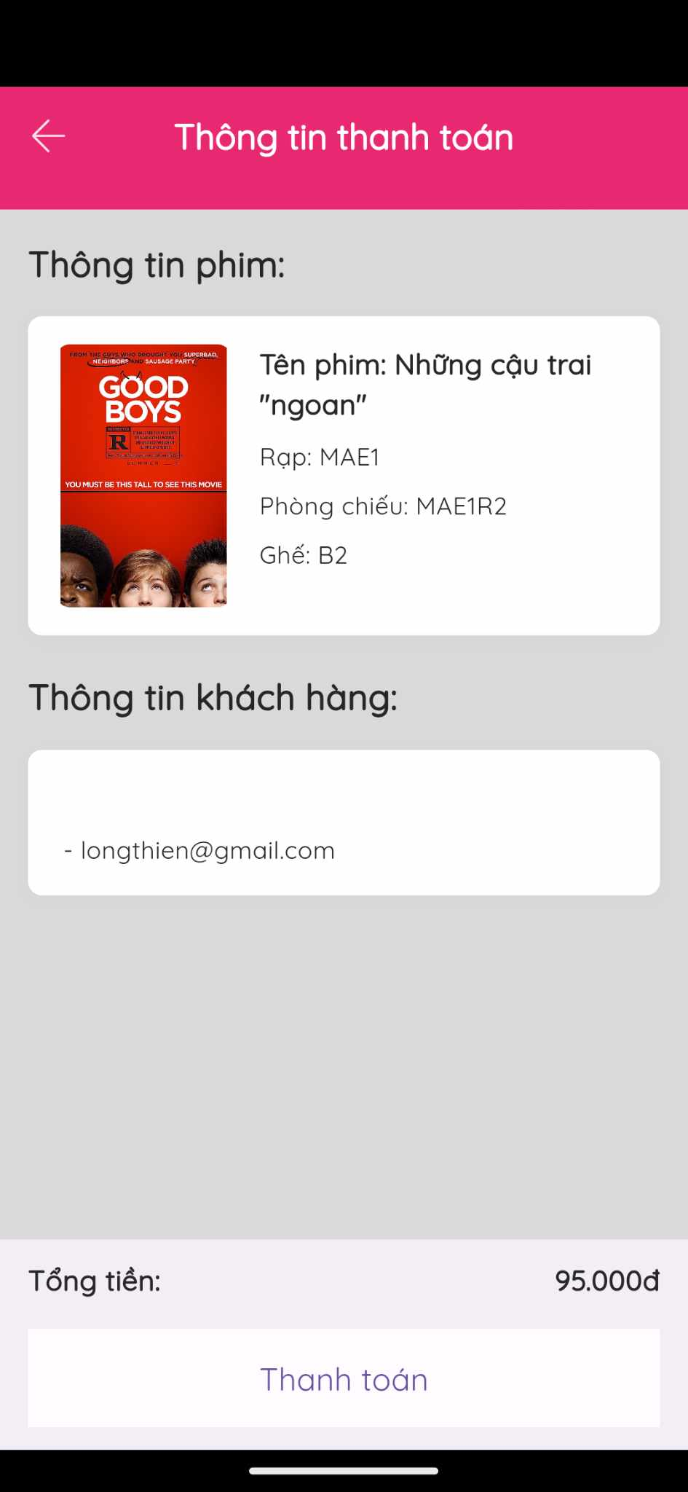
4. User Interface Design
Book Tickets
Screen 4
Screen 5

Slide 50
Thanks

